Slide 1
Sales Dashboard Project
Data Analyst Internship – Task 4
Dibyanshi Rath Power BI

Slide 2
Objective
To design an interactive dashboard for business stakeholders.
To analyze sales and profit performance .
To present insights in a visual and easy-to-understand way

Slide 3
Dataset
Dataset Type: Sales Data Fields Used: Date
Region
Category
Sales
Profit
Source: Kaggle / Sample dataset

Slide 4
Tools Used
Power BI (for dashboard creation).
CSV Dataset.
Basic Data Visualization Techniques

Slide 5
Dashboard Features
Sales trend analysis using charts
Profit analysis by category
Region-wise sales comparison
Interactive filters (slicers) for Region and Date
KPI cards showing total Sales and Profit

Slide 6
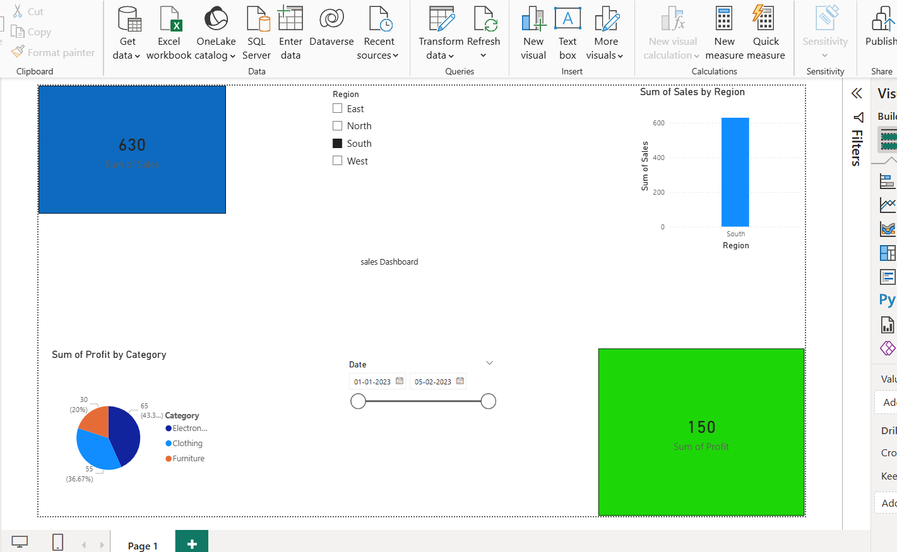
Dashboard

Slide 7
Insights
Sales vary across different regions.
Some categories generate higher profit than others.
Dashboard helps in quick decision-making.
Interactive filters allow better data exploration

Slide 8
Conclusion
Dashboard provides clear business insights.
Helps stakeholders understand performance quickly.
Improves decision-making using visual data .

